Slide 1


Joseph Harmonson
10/17/2022

Slide 2

Outline
Executive Summary
Introduction
Methodology
Results
Conclusion
Appendix

Slide 3

Executive Summary
Summary of methodologies
Data Collection
Data Wrangling
Exploratory Data Analysis (EDA) with Data Analysis
EDA with SQL
Interactive Maps with Folium
Interactive Dashboard
Predictive Analysis with Machine Learning
Summary of all results
EDA results
Interactive Dashboard with screenshots
Machine Learning Results

Slide 4

Introduction
Project background and context
SpaceX has shaken space exploration with its ability to create cheaper rockets. This cost reduction is made possible due to its rocket reusability. This cuts the cost by approximately $100 million. If we can determine whether the first stage can be reused due to a successful landing, we can determine the cost to continue a program similar to SpaceX.
Problems you want to find answers
What factors determine a successful landing of the first stage?
What variables impact the success rate?
What conditions provide the best results?

Slide 5

Section 1

Slide 6

Methodology
Executive Summary
Data collection methodology:
Get request to the SpaceX API
Web scrapping from Wikipedia
Perform exploratory data analysis (EDA) using visualization and SQL
Perform interactive visual analytics using Folium and Plotly Dash
Perform predictive analysis using classification models
Built, tuned, and evaluated classification models
Logistic Regression, K Nearest Neighbor, Data Classification Tree, and Support Vector Machine

Slide 7

Data Collection
Request to the SpaceX API
Requested data was cleaned and missing values were removed
Data was scraped from Wikipedia Launch Records
Data was parsed and converted to a Pandas data frame

Slide 8

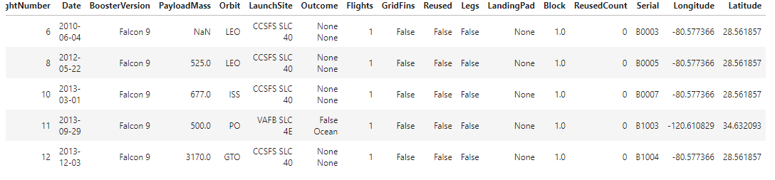
Data Collection – SpaceX API
SpaceX API notebook with outcomes
Declare URL for API
Normalize to Pandas Data Frame
Filter out redundancies
Generate lists and functions
Filter only Falcon 9 data
Remove Null Values

Slide 9
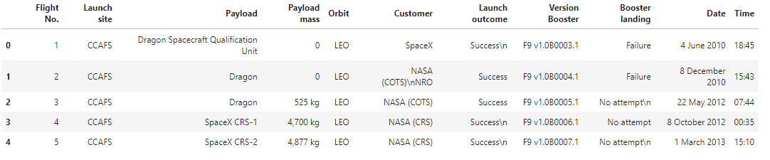
Data Collection - Scraping
Extract a Falcon 9 launch records HTML table from Wikipedia
Parse the table and convert it into a Pandas data frame
Web Scrapping Notebook GitHub URL
Extract data from Wikipedia
Filter only necessary information
Iterate table to filter out redundancies
Populate dictionary
Append Data
Create data frame

Slide 10

Data Wrangling
Exploratory Data Analysis
Determine Training Labels
Calculate the number of launches on each site
Calculate the number and occurrence of each orbit
Calculate the number and occurrence of mission outcome per orbit
Create a landing outcome label from outcome column
Data Wrangling Notebook GitHub URL

Slide 11
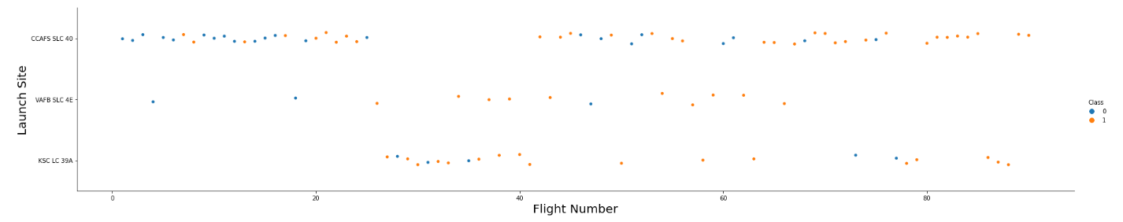
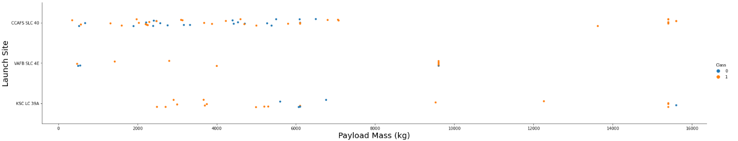
EDA with Data Visualization
EDA with Data Visualization GitHub URL
Perform exploratory Data Analysis and Feature Engineering using Pandas and Matplotlib using visuals

Slide 12
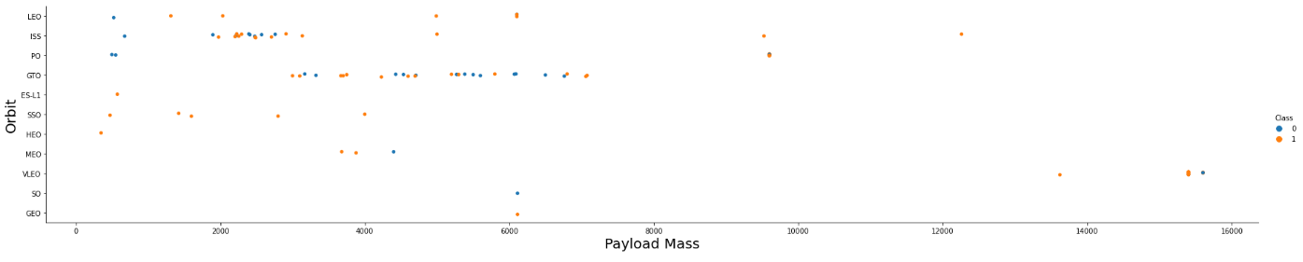
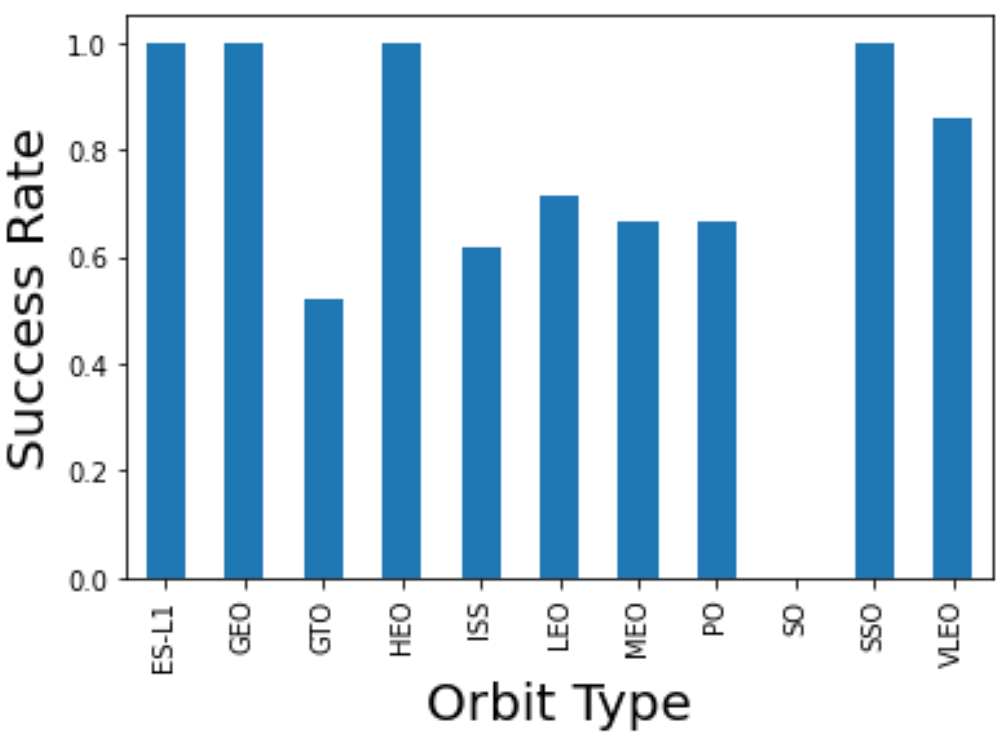
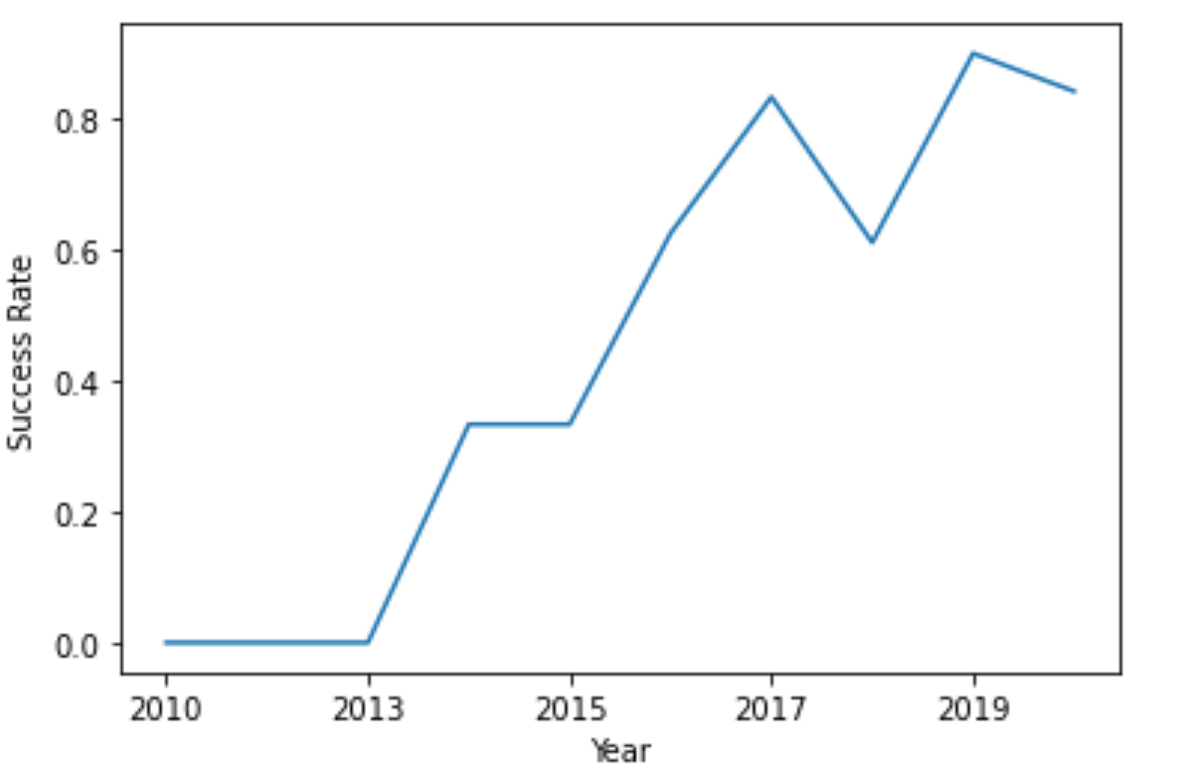
EDA with Data Visualization

Slide 13
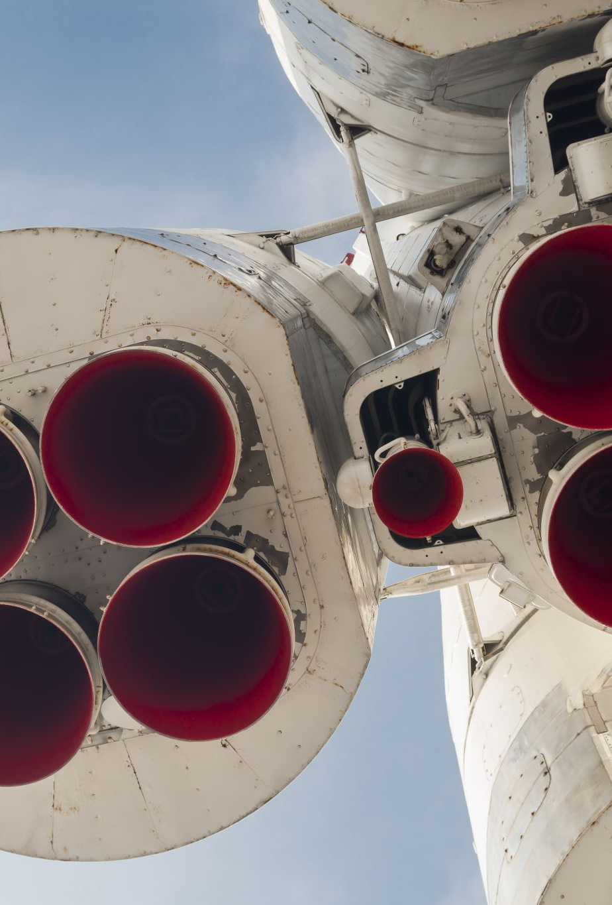
EDA with SQL
EDA with SQL GitHub URL
Display the names of the unique launch sites in the space mission
Display 5 records where launch sites begin with the string 'CCA'
Display the total payload mass carried by boosters launched by NASA (CRS)
Display average payload mass carried by booster version F9 v1.1
List the date when the first successful landing outcome in ground pad was achieved.
List the names of the boosters which have success in drone ship and have payload mass greater than 4000 but less than 6000
List the total number of successful and failure mission outcomes
List the names of the booster_versions which have carried the maximum payload mass. Use a subquery
List the failed landing_outcomes in drone ship, their booster versions, and launch site names for in year 2015
Rank the count of landing outcomes (such as Failure (drone ship) or Success (ground pad)) between the date 2010-06-04 and 2017-03-20, in descending order

Slide 14
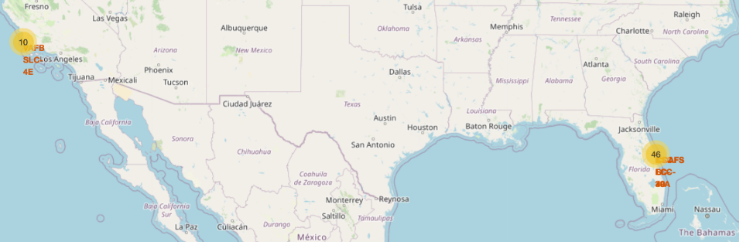
Build an Interactive Map with Folium
Interactive Map with Folium GitHub URL
Mark all launch sites on a map
Mark the success/failed launches for each site on the map
Calculate the distances between a launch site to its proximities

Slide 15
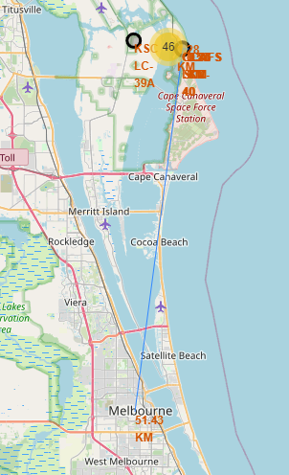
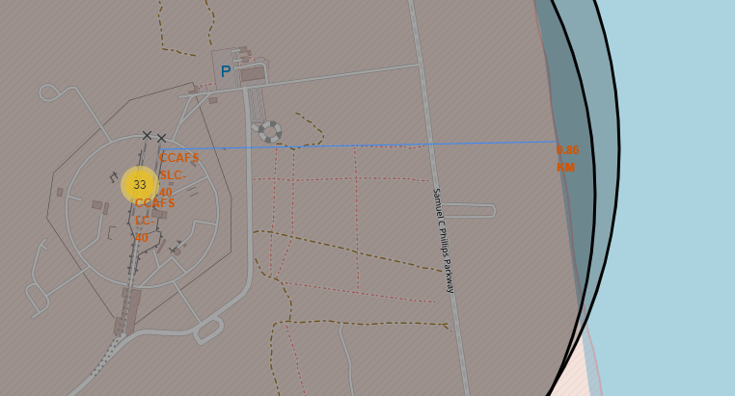
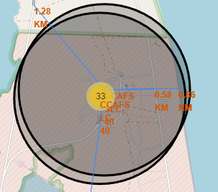
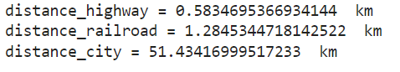
Build an Interactive Map with Folium

Slide 16
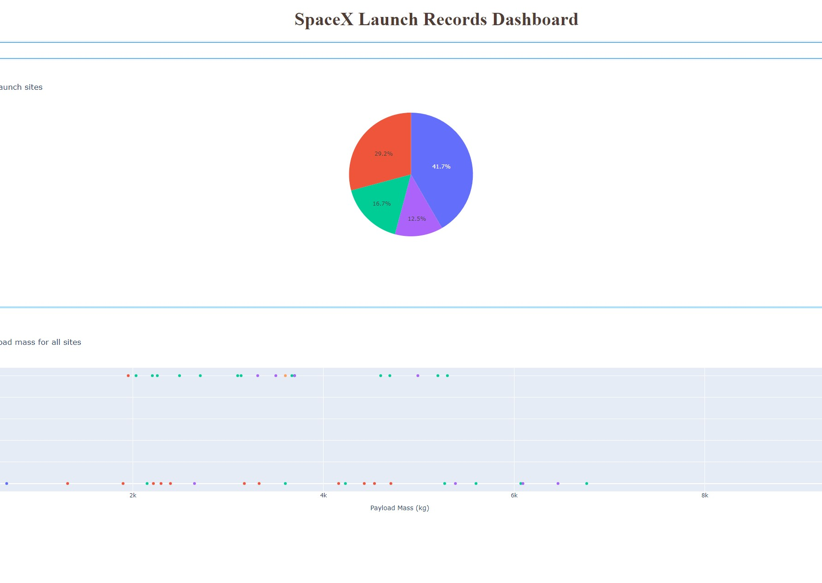
Build a Dashboard with Plotly Dash
Dashboard with Ployly Dash GitHub URL
I used Dash to create an interactive dashboard to analyze the data from the launches and launch sites.

Slide 17
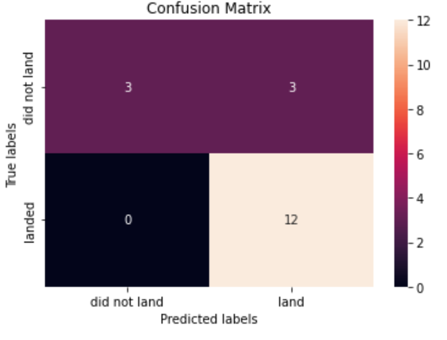
Predictive Analysis (Classification)
Machine Learning Prediction GitHub URL
Logistic Regression, K Nearest Neighbor, Data Classification Tree, and Support Vector Machine
Predictions performed at 83%

Slide 18

Section 2

Slide 19
Flight Number vs. Launch Site
The scatter plot above displays the Flight Number vs Launch Site
Class 1 refers to a success
Class 0 refers to a failure

Slide 20
Payload vs. Launch Site
The scatter plot above displays the Payload vs Launch Site
Class 1 refers to a success
Class 0 refers to a failure

Slide 21
Success Rate vs. Orbit Type
This plot displays the Payload vs Orbit Type

Slide 22
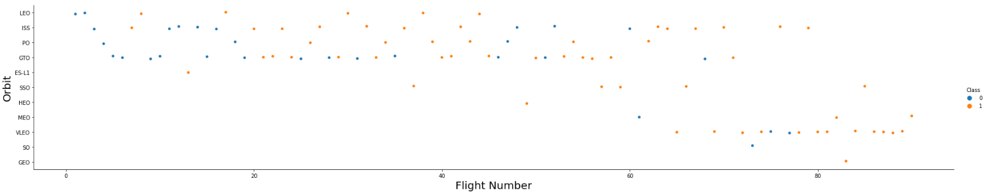
Flight Number vs. Orbit Type
The scatter plot above displays the Flight Number vs. Orbit Type
Class 1 refers to a success
Class 0 refers to a failure

Slide 23
Payload vs. Orbit Type
The scatter plot above displays the Payload vs. Orbit Type
Class 1 refers to a success
Class 0 refers to a failure

Slide 24
Launch Success Yearly Trend
This graphs shows the yearly trend of launch successes.

Slide 25
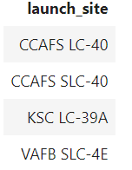
All Launch Site Names
Display the names of the unique launch sites

Slide 26
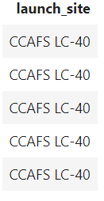
Launch Site Names Begin with 'CCA'
Find 5 records where launch sites begin with `CCA`

Slide 27
Total Payload Mass
Calculate the total payload carried by boosters from NASA
45,596 KG

Slide 28
Average Payload Mass by F9 v1.1
Calculate the average payload mass carried by booster version F9 v1.1
2,534 KG

Slide 29
First Successful Ground Landing Date
Find the dates of the first successful landing outcome on ground pad
12/22/2015

Slide 30
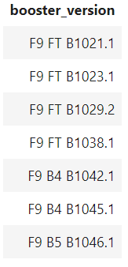
Successful Drone Ship Landing with Payload between 4000 and 6000
List the names of boosters which have successfully landed on drone ship and had payload mass greater than 4000 but less than 6000

Slide 31
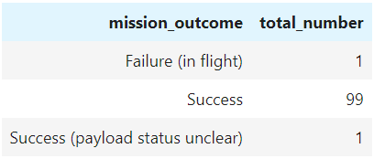
Total Number of Successful and Failure Mission Outcomes
Calculate the total number of successful and failure mission outcomes

Slide 32
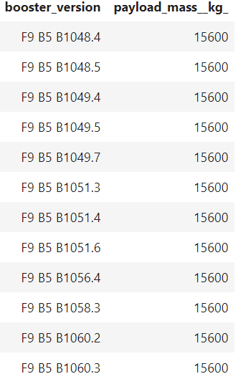
Boosters Carried Maximum Payload
List the names of the booster which have carried the maximum payload mass

Slide 33
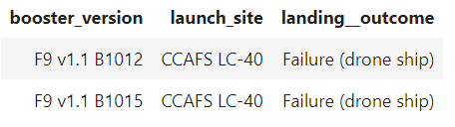
2015 Launch Records
List the failed landing_outcomes in drone ship, their booster versions, and launch site names for in year 2015

Slide 34
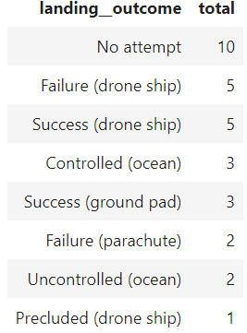
Rank Landing Outcomes Between 2010-06-04 and 2017-03-20
Rank the count of landing outcomes (such as Failure (drone ship) or Success (ground pad)) between the date 2010-06-04 and 2017-03-20, in descending order

Slide 35

Section 3

Slide 36
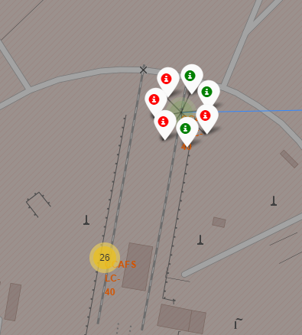
Cluster Map of Launch Sites
This map is a cluster of launch sites. When you zoom in on each cluster, it will show you specific launch sites with outcomes.

Slide 37
Luanch Map with Outcomes and Proximities
The map was used to determine the distances from railways, highways, coastline and cities. The launch sites are in close proximity to railways and highways to allow for easy transportation. They are in close proximity to the coast in case of a failure they can touch down in water. Launch sites are away from major cities to keep clear of large populations.

Slide 38
Proximity Map with Folium
This map shows the distances between the railway, highway, coastline, and the closest major city.

Slide 39

Section 4

Slide 40
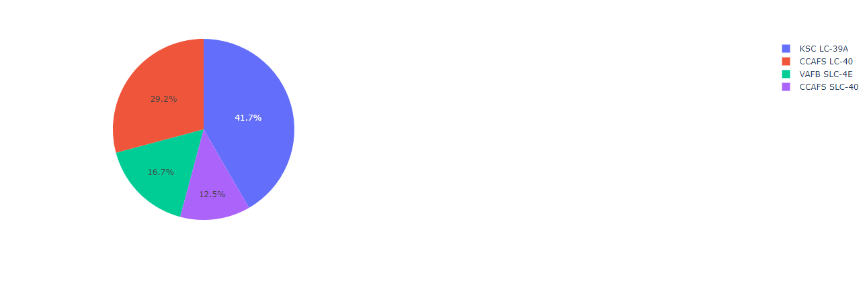
Dashboard Launch Success Count
The screenshot shows the launch success count for all sites

Slide 41
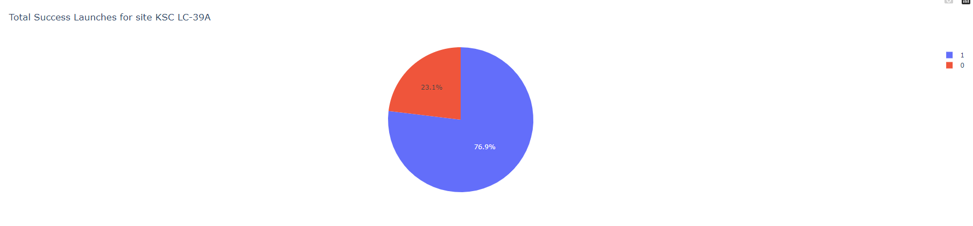
Dashboard Highest Launch Success Ratio
The screenshot shows the launch site with the highest launch success ratio. The #1 or blue area means a successful launch.

Slide 42
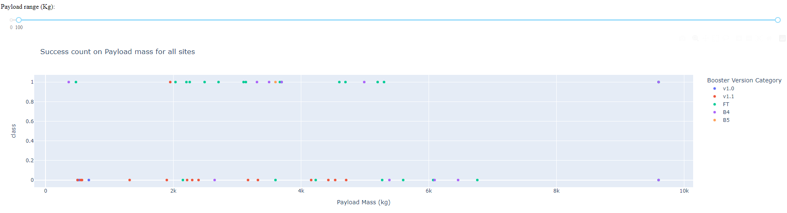
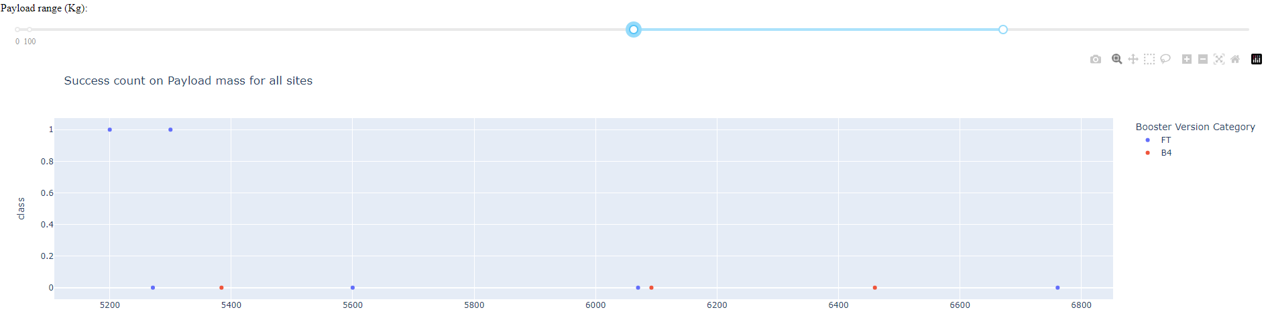
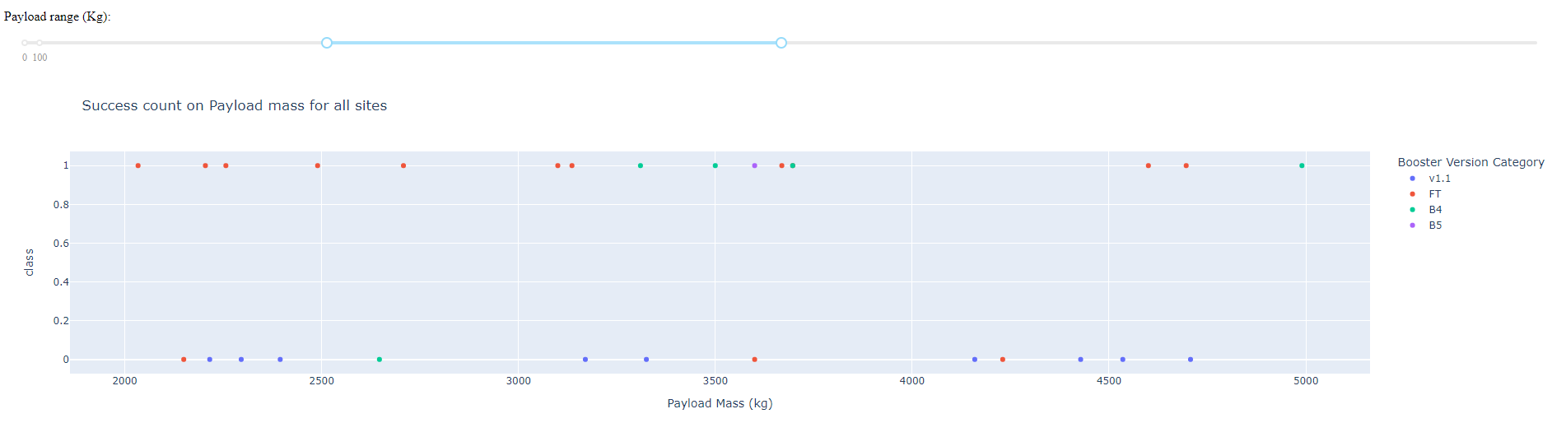
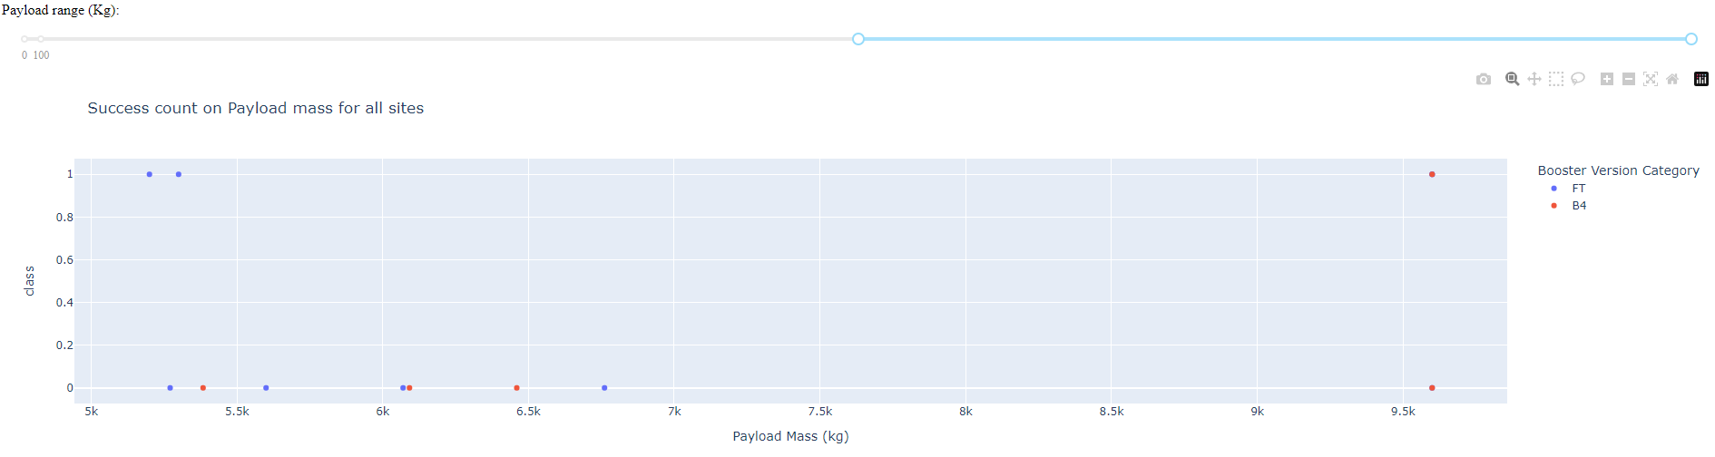
Dashboard Payload vs. Launch Outcome
These screenshots show the Payload vs. Launch Outcome scatter plots for all sites, with different payloads selected in the range slider.

Slide 43

Section 5

Slide 44
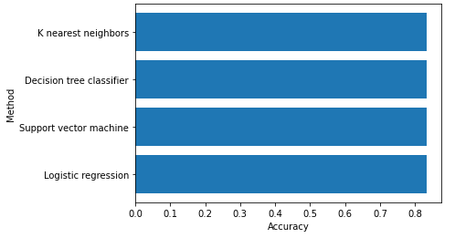
Classification Accuracy
Based on my prediction analysis, all methods contained the same accuracy of 83%. We can feel confident that our training and testing data can be used for accurate predictions for success.

Slide 45
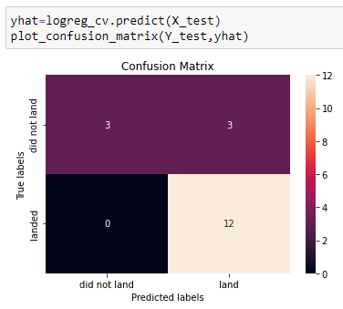
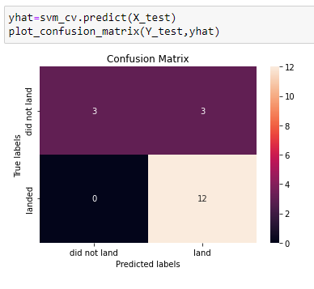

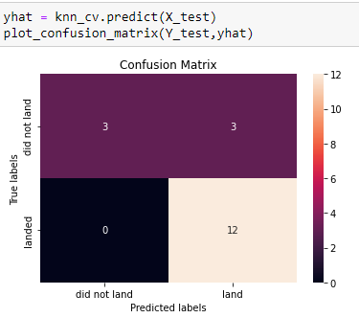
Confusion Matrix
Since all models performed with the same accuracy, we have very similar confusion matrixes.

Slide 46
Conclusions
As the number of flights increased, the success rate increased. The more rockets launched the better you will get at successful launches.
The orbit types impact the success rate. SSO, HEO, GEO, and ES-L1 are preferred orbits for a successful launch.
Booster version KSLC-39A is the best version. It had the highest number of successful launches and landings.
The higher the payload the more of an impact it has on the success of the launch. Using maximum payloads is not advised.
All predictive models achieved 83%. More data needs to be collected to ensure accurate predictions.

Slide 47


